Slide 1


UPES
UNIVERSITY WITH A PURPOSE

Slide 2
Synopsis Presentation
Major II
Ankur Sehrawat | Deepen Lakra | Anubhav Deshwal | Akshat Kaushik
500069004 | 500069625 | 500069112 | 500067066
R171218023 | R171218035 | R171218023 | R171218012
Under the guidance of
Dr. Sonali Vyas
Assistant Professor

Slide 3

HOPE (University Blood Donation Application

Slide 4
Abstract
There is an expectation that the blood will always be there when it is really needed. Blood donor volunteers constitute the main supply source in an effective blood supply chain management. They feed blood stocks through their donation. In an emergency situation, if the stocks are insufficient, the only source of blood supply will be the people who come to the health center and donate the blood on a voluntary basis. It is certain that time is a very important component in such a situation. For this reason, the health care center should call the nearest available donor in order to ensure to get the service as quickly as possible. A smart phone application is developed to facilitate the identification of the nearest available blood donor volunteer and the communication with him/her in the emergency situations where the blood can’t be supplied through the blood banks’ stocks. This Application mainly focuses on Students encouraging them to participate in blood donation camps in university itself and in case of medical emergencies providing help through this application.

Slide 5

INTRODUCTION
There is an absence of mindfulness towards blood doantion among an impressive level of students. This outcomes in helpless interest in blood donation among this population. In this way there is a basic requirement for culture college students to know and work on their demeanor towards donating blood. Additionally students living away from their families might have health related crises. During such occasions getting fast assistance is troublesome as they need more contacts. Such circumstances are unpleasant and requesting help is time consuming.A advanced mobile application is created to work with the recognizable proof of the closest accessible blood contributor volunteer and the correspondence with him/her in the crisis circumstances where the blood can't be provided through the blood donation centers' stocks. This Application predominantly centers around Students empowering them to donate blood through blood donation camps in college itself and in the event of health related crises giving assistance through this application.

Slide 6
Problem Statement
There is a lack of awareness and a negative attitude towards blood donation among a considerable percentage of students. This results in poor participation in blood donation among this population. Therefore there is a critical need for culture university students to be aware and improve their attitude towards blood donation. Also students living away from their families may have medical emergencies. During such times getting quick help is difficult as they don’t have enough contacts. Such situations are stressful and asking for help is time consuming.

Slide 7
Objective
The objectives of this project are.
To create an effective digital solution.
Reaching a large number of people in an emergency to find blood.
Find active blood donors and other information about them.
Able to track when a student last time donated.
Able to book appointments with blood banks according to your schedule.
Quick Registration through application.
Spreading Awareness about healthcare

Slide 8
Methodology
1
Study and analyze the different research papers, articles and materials to propose solution for
2
Adding user authentication via Email and user need to verify his/her email to access the application
3
Developing NearBy donar Functionality
4
Test the models and find the best performance.
5
Built the Interactive UI for users.
6
Finding the best Libraries and implementing those into the project.

Slide 9
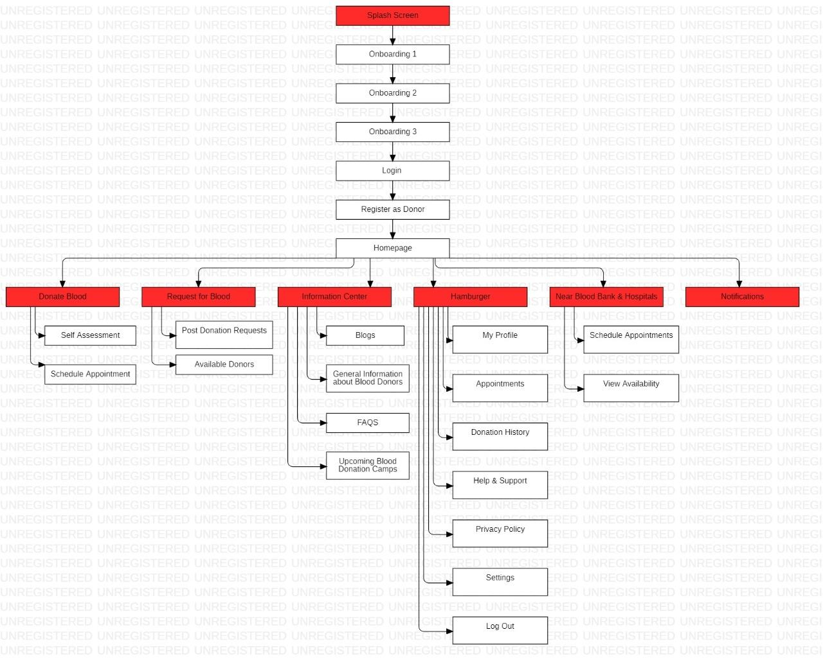
Information Application Architecture:

Slide 10
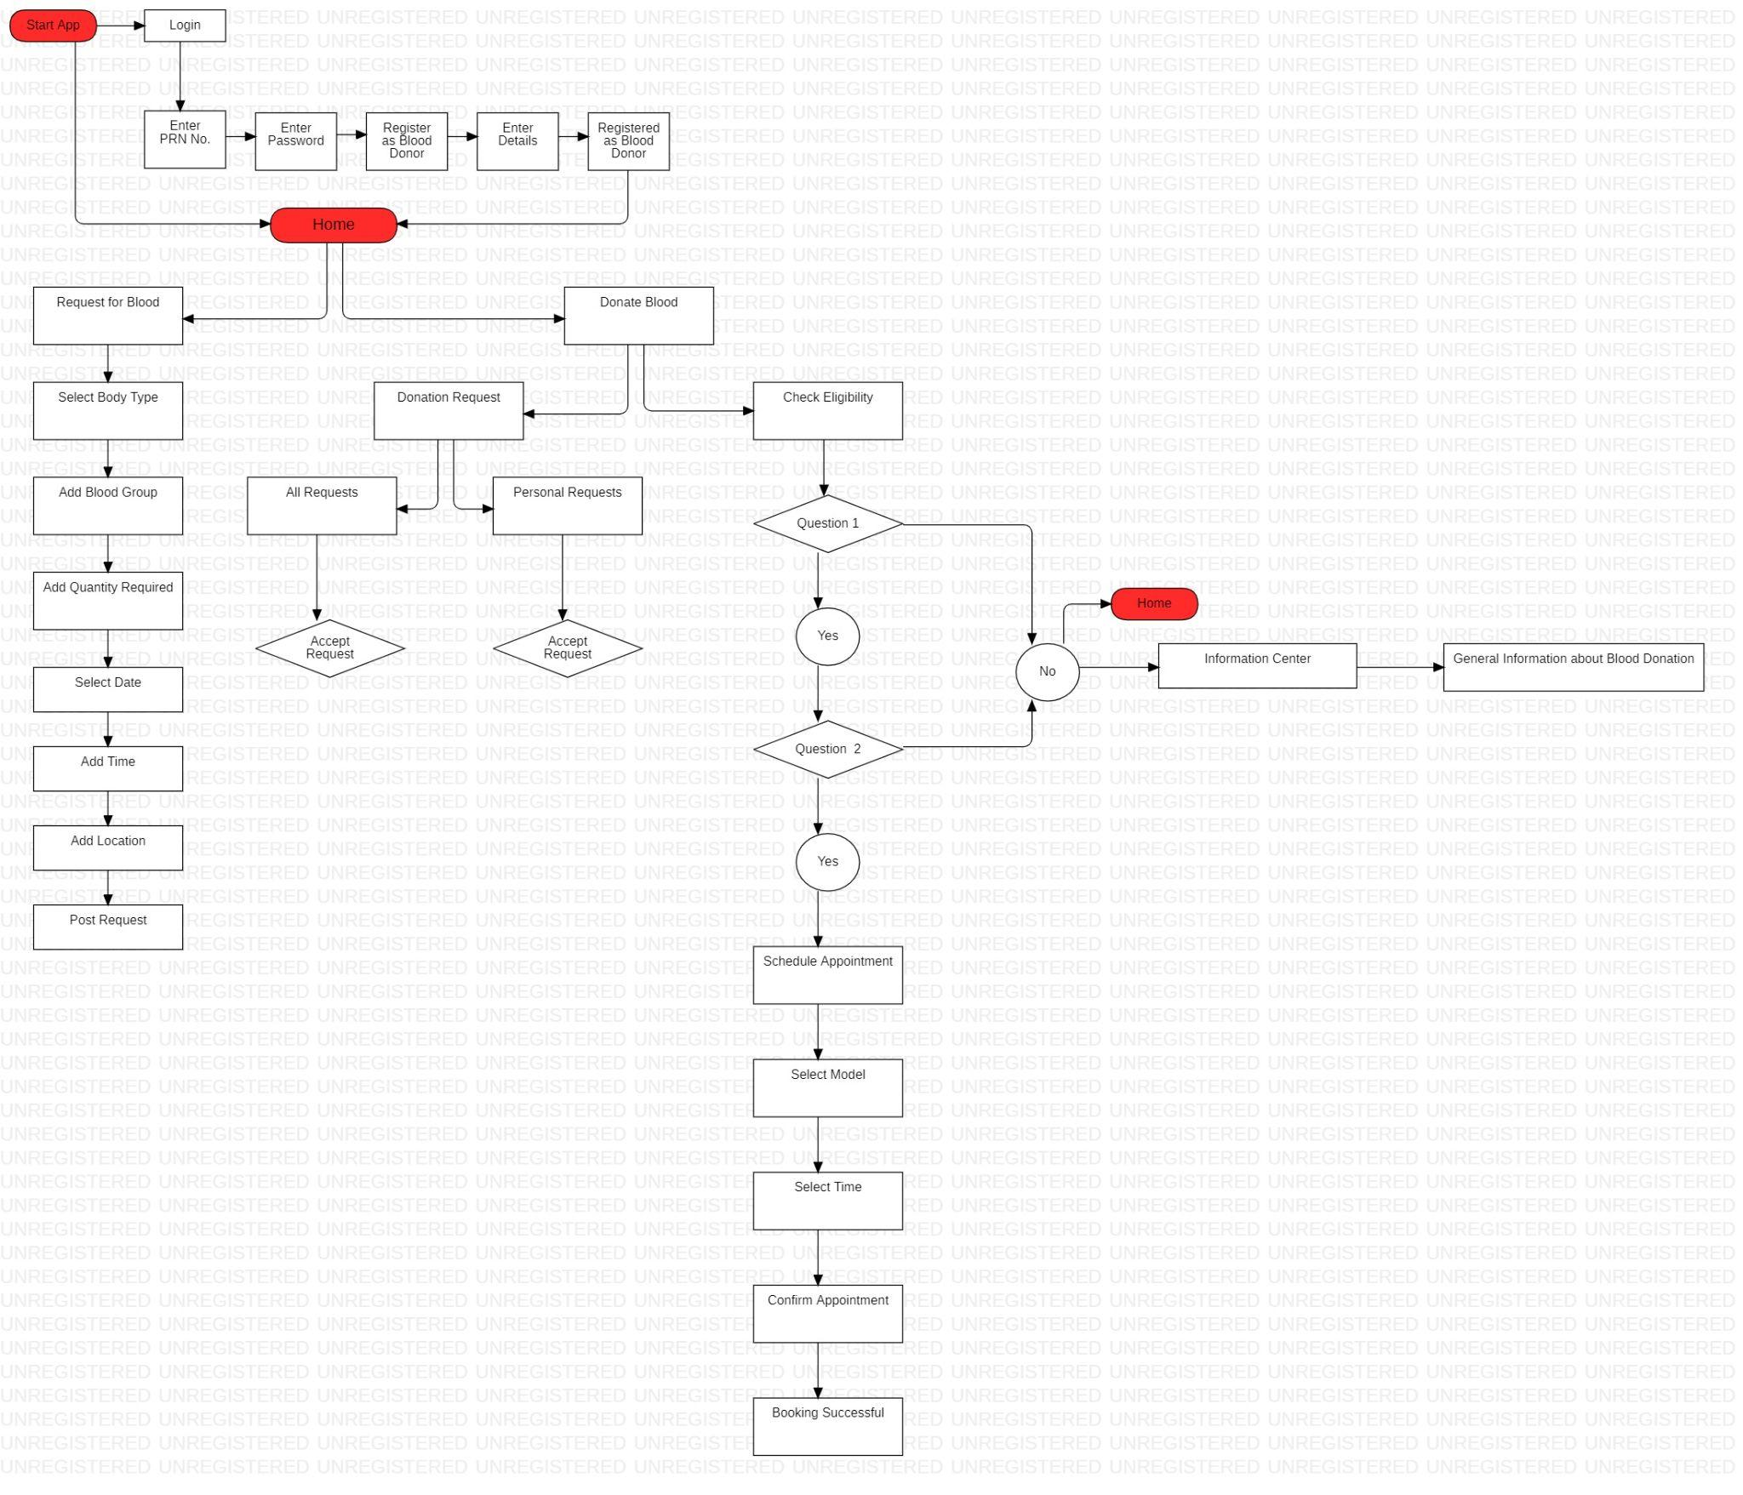
User flow diagram:

Slide 11
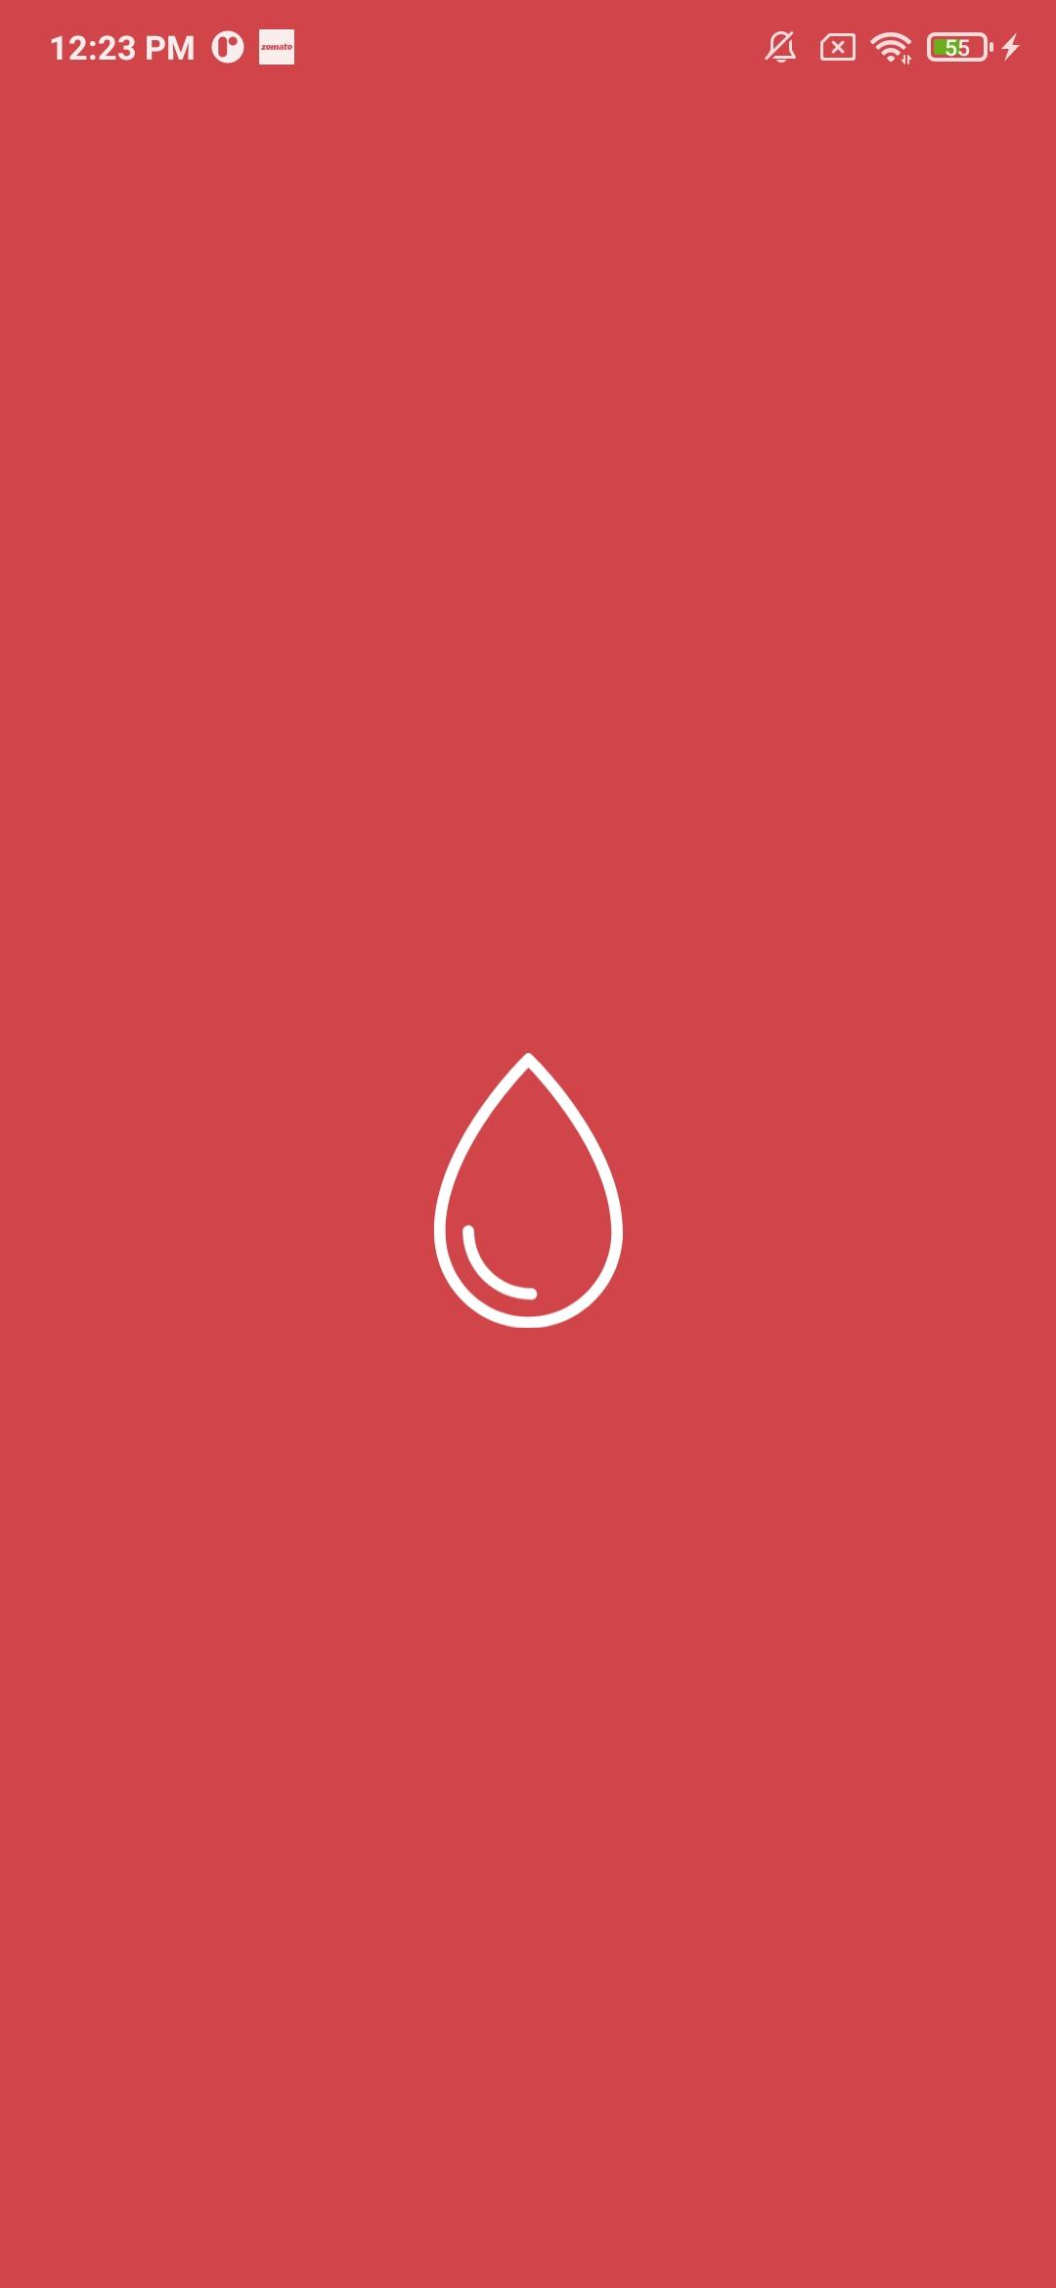
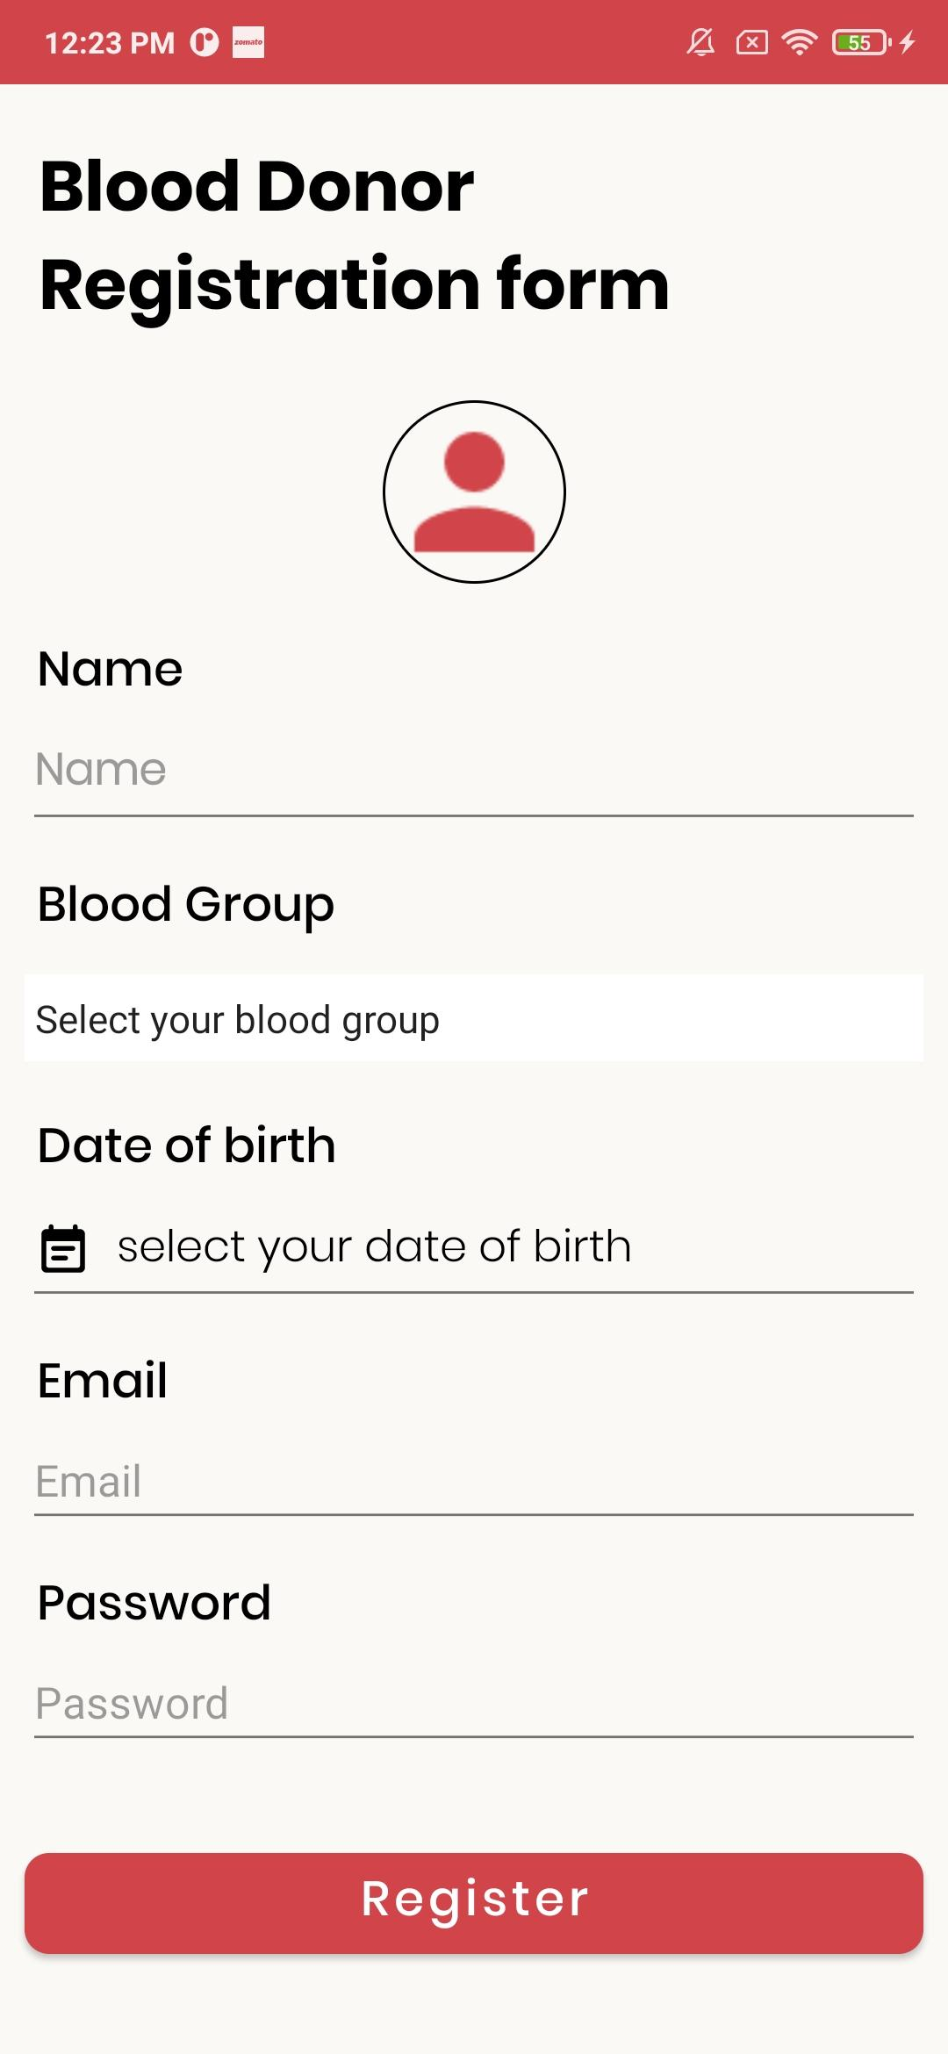
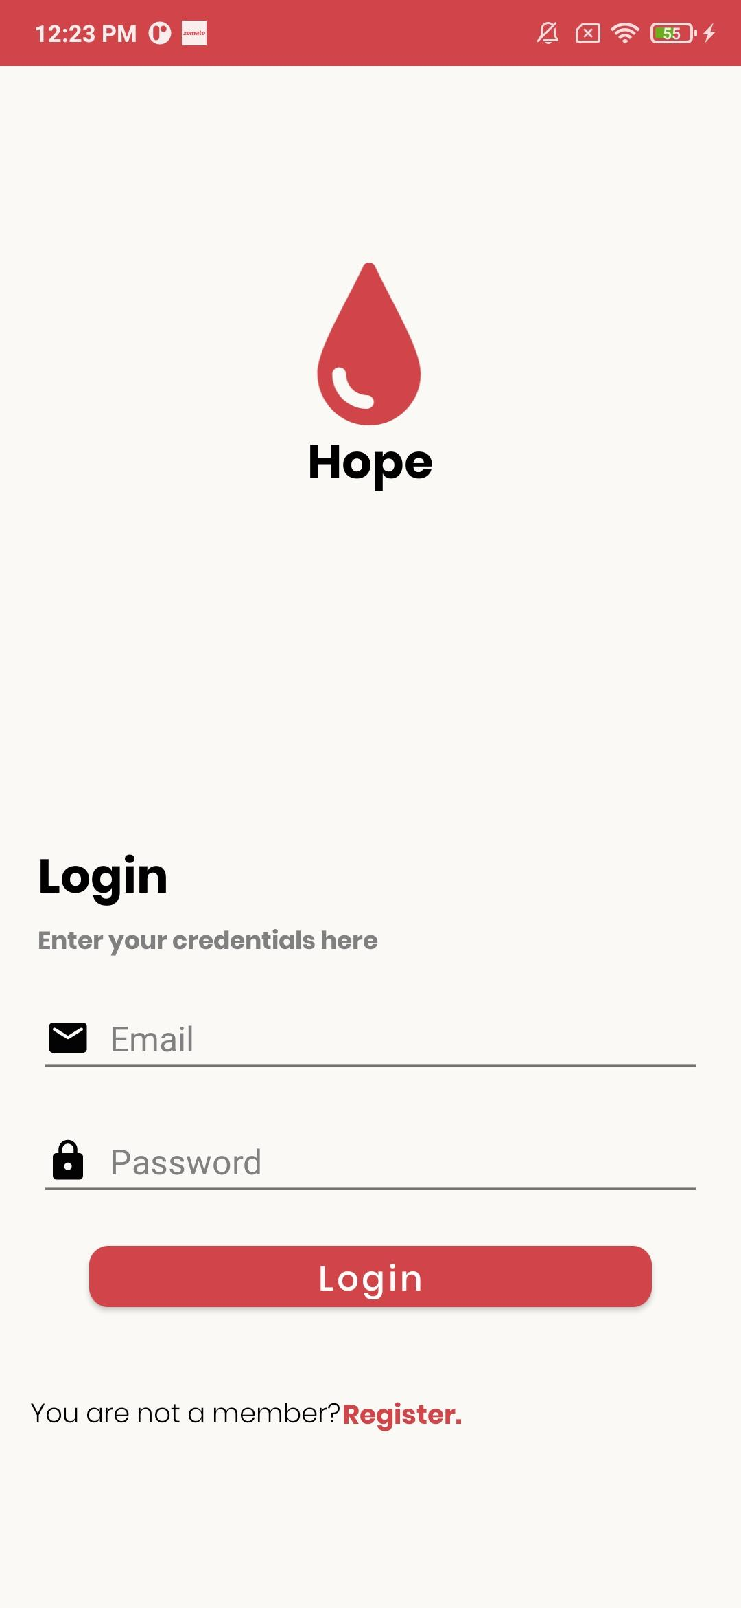
WORK DONE SO FAR:

Slide 12
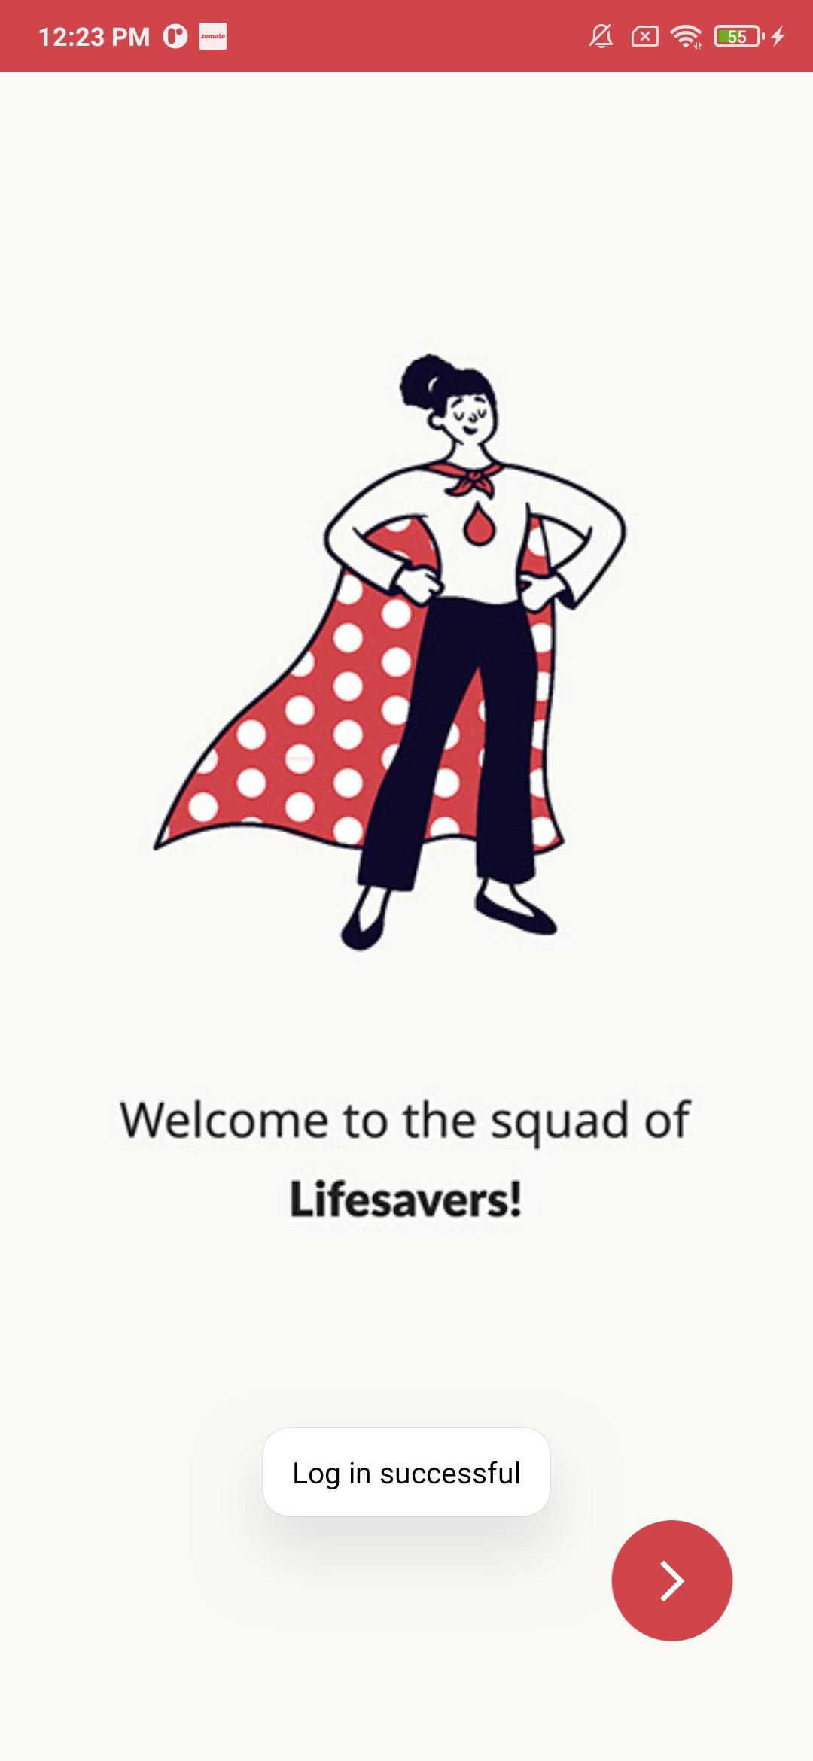
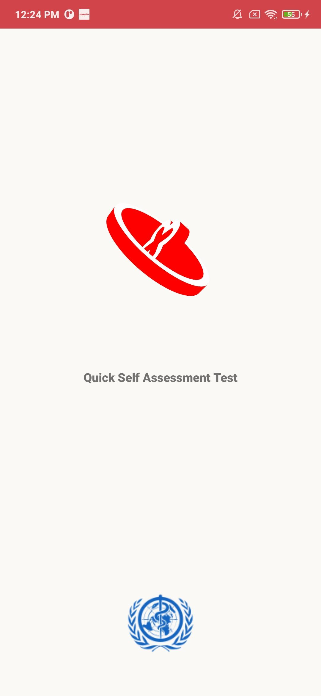
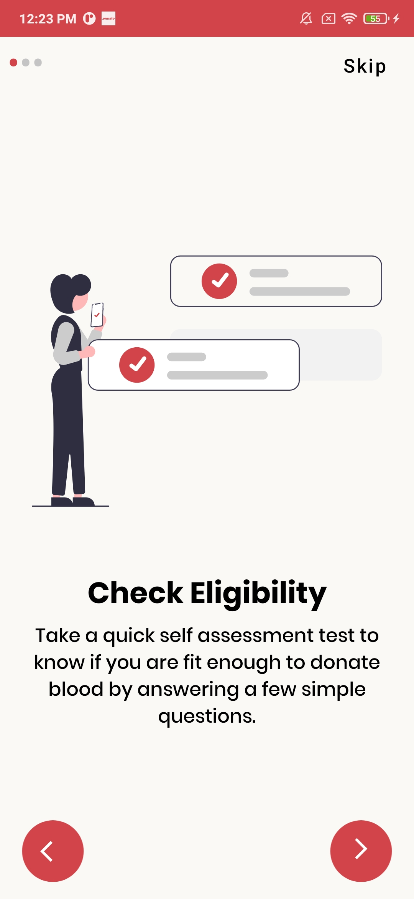

Slide 13
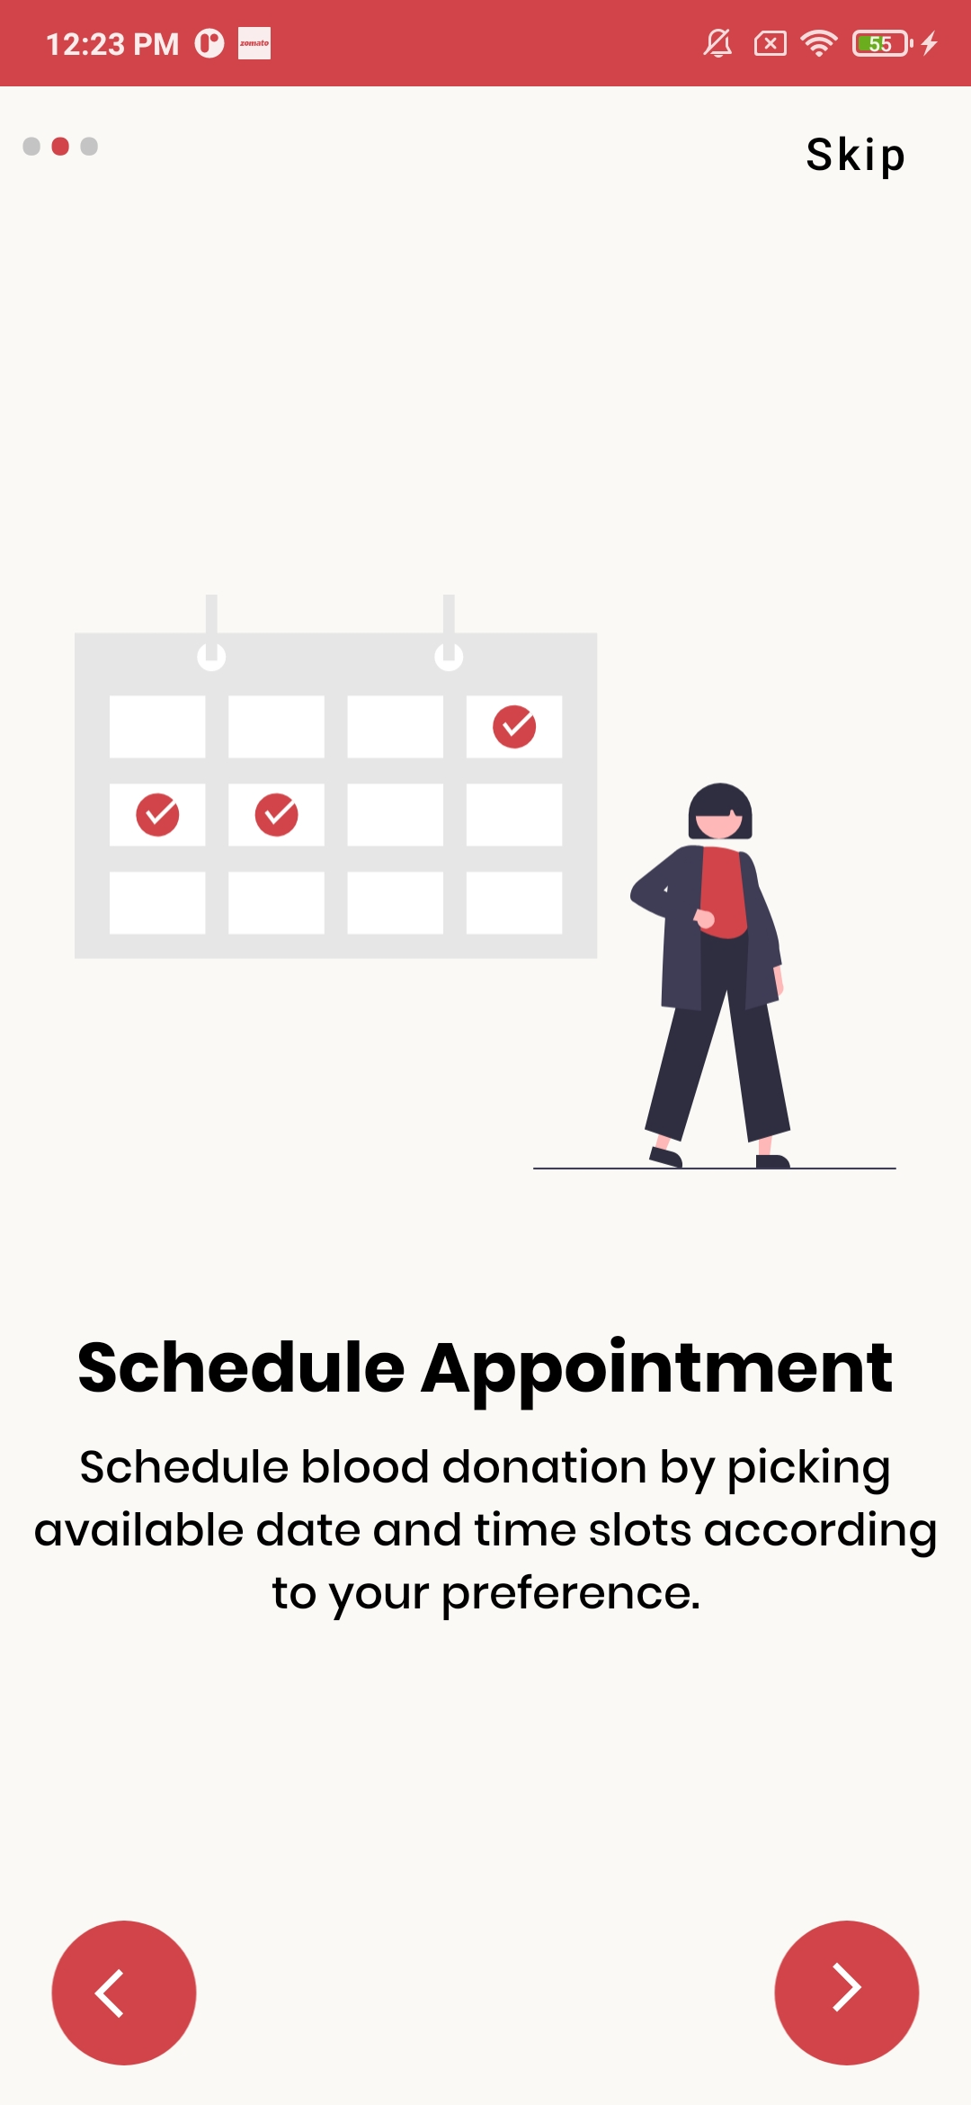
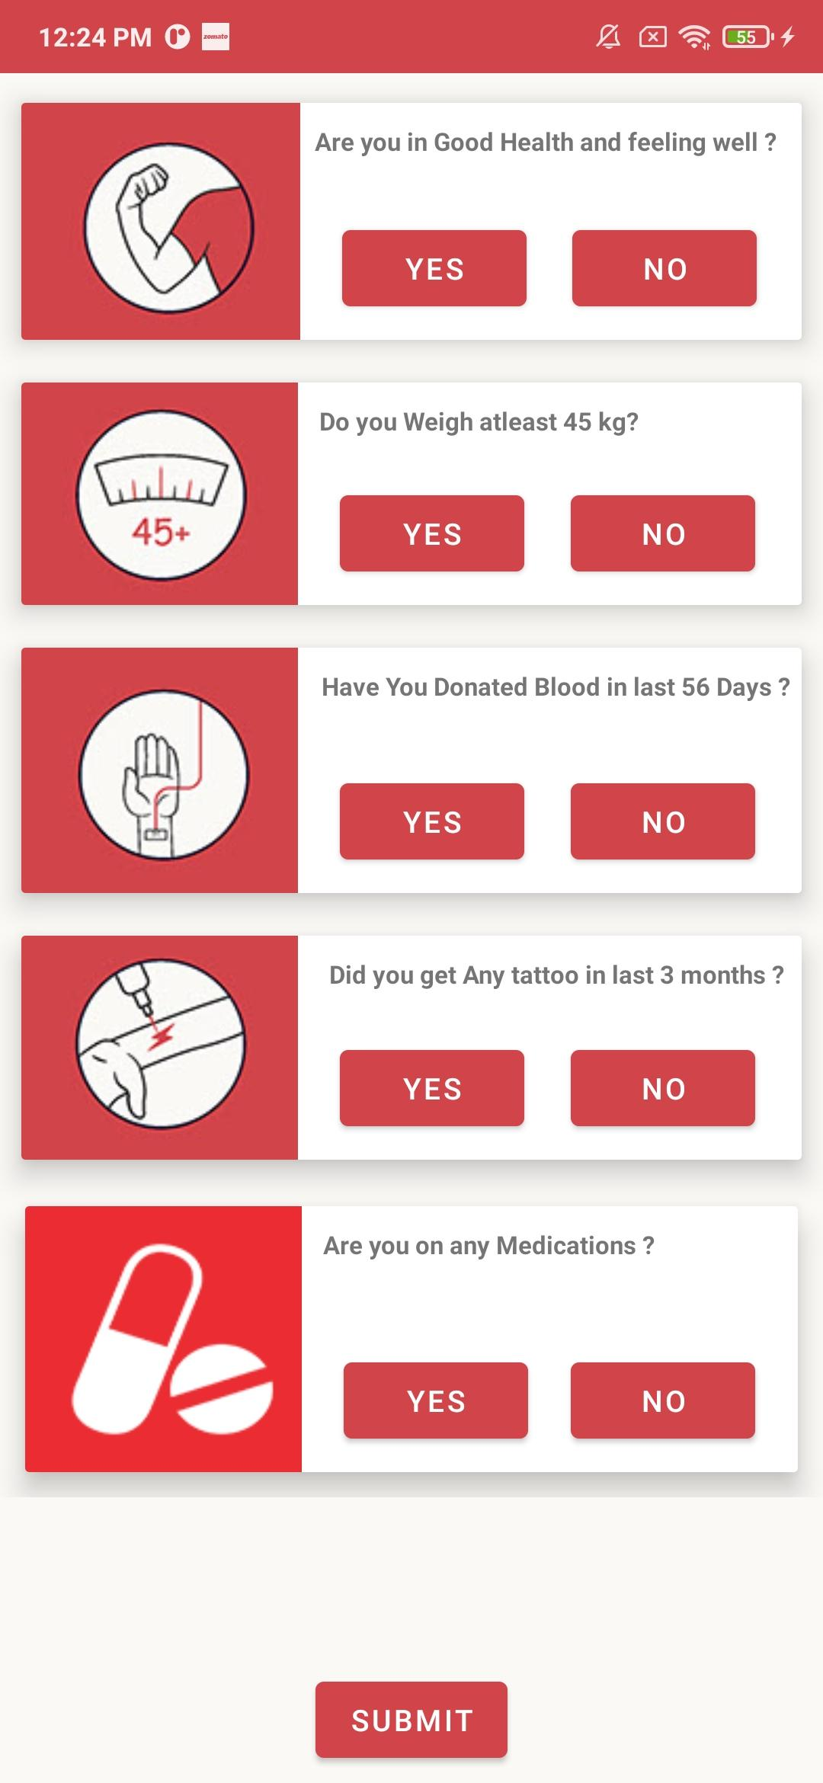
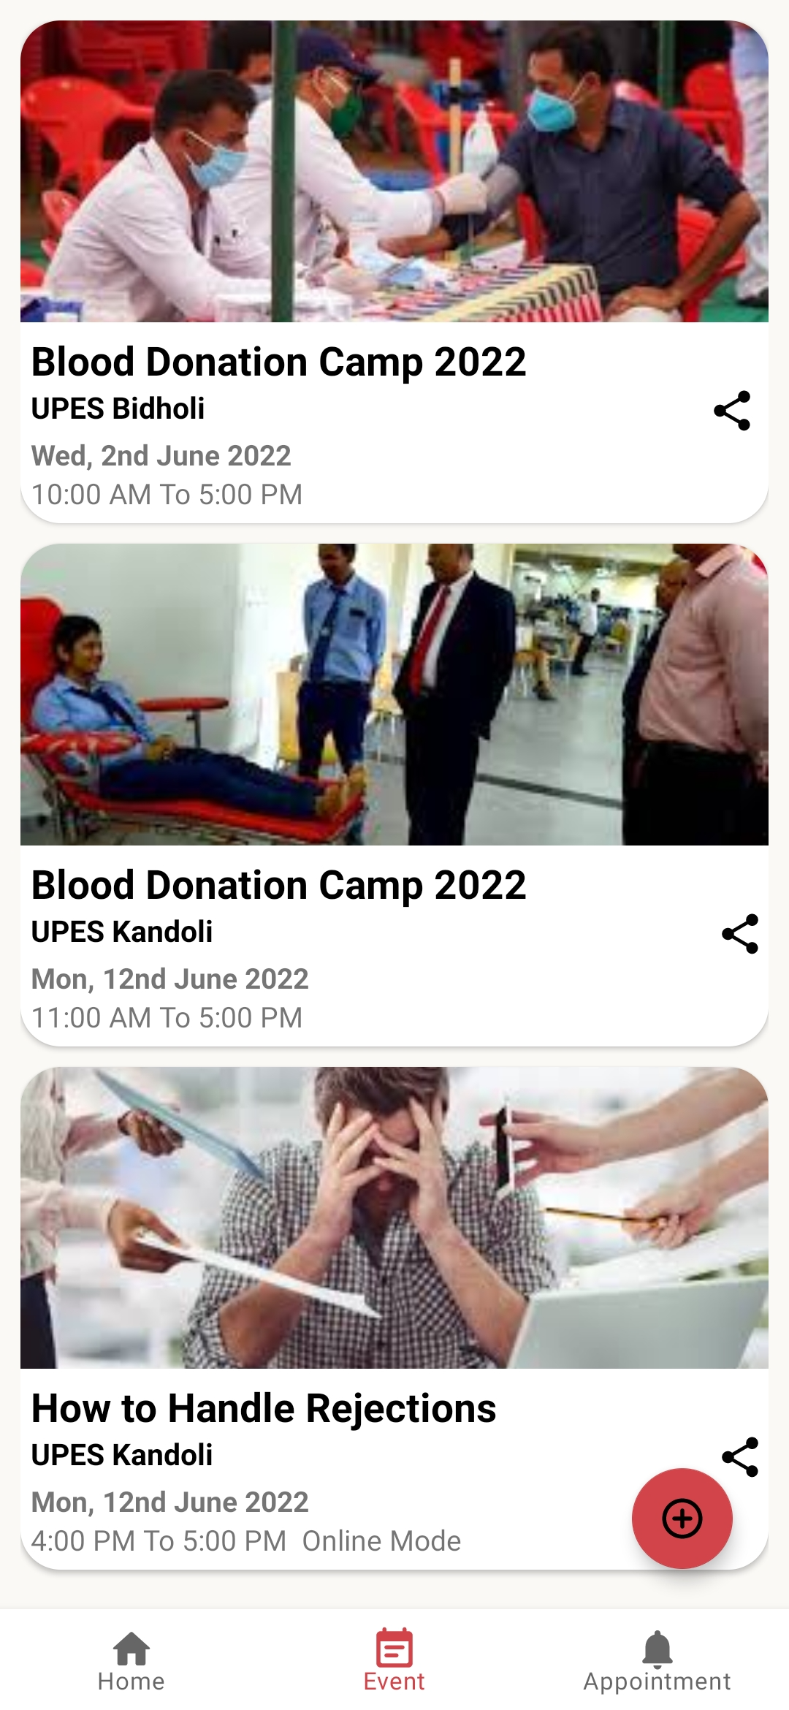

Slide 14
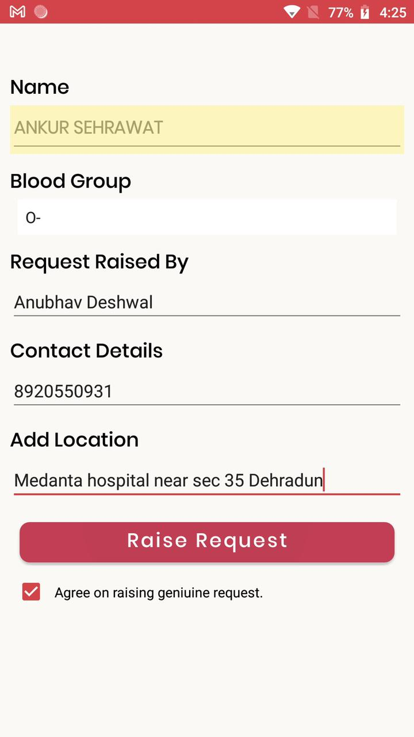
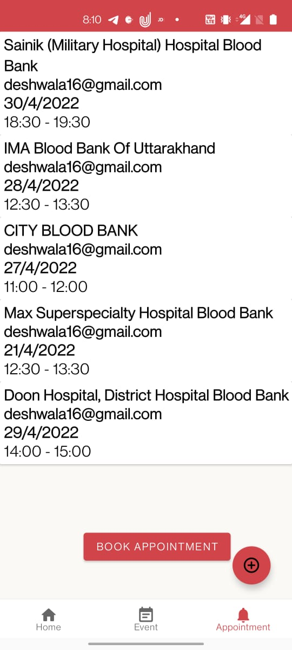
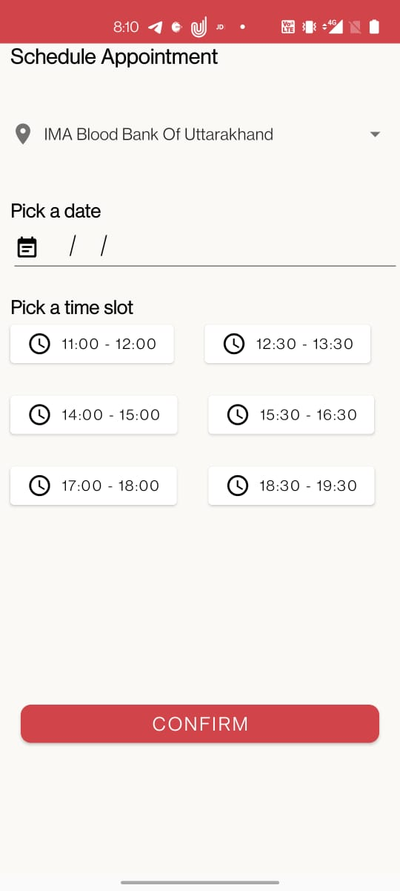

Slide 15
SUMMARY:
We planned to establish an effective digital solution for blood donation for our project: HOPE. We've created a platform that allows us to identify blood donors and even donate blood through a blood donation camp listed on our app. This can be accomplished by taking the following steps:
The user must first register and then login to our app.
After logging in, the user will be required to take a simple self-assessment test.
After passing the exam, the user must meet an eligibility condition for blood donation, which is based on previous blood donation history and whether or not the user has any ailments.
If the user wants to donate blood, he or she can go to the events area and schedule an appointment for the nearest blood donation drive at a time that is convenient for them.
If a user needs blood and needs it now, he or she can go to the raise an issue tab and look for nearby blood donors who match the appropriate blood group.

Slide 16


System Requirements
Software requirements:
Kotlin
Android Studio
Android Library
FireBase
Operating System(Windows and Android)
Hardware requirements:
8GB RAM
Windows 10 / MacOS (Catalina) / Linux-Ubuntu

Slide 17
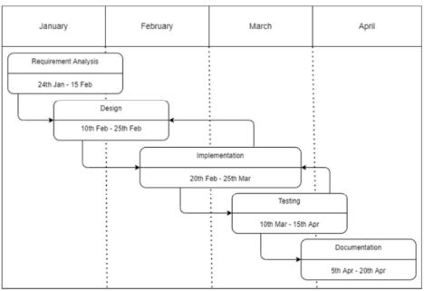
PERT CHART:

Slide 18
References
https://www.researchgate.net/publication/349000171_DEVELOPMENT_ OF_A_BLOOD_BANK_INFORMATION_RETREIVAL_SYSTEM_US ING_ANDROID_APP
https://ijcrt.org/download.php?file=IJCRT2105420.pdf
https://ieeexplore.ieee.org/document/9378752
https://www.behance.net/gallery/133465165/Hope-University-BloodDonation-App

Slide 19
THANK YOU
THANK YOU
UPES
UNIVERSITY WITH A PURPOSE

